Slide 1
INFO2000 Fundamentals of Systems Analysis and Design
Susan Benvenuti
Friday, 12 February 2015
LB 144

Slide 2
Some homework …
Using any South African recruitment web site…
… post the details of an IS job that you would like to apply for one day to the “IS Jobs” forum topic on Wits-e
Include the job title, the job description, the skills required, the company/organisation offering the position and advertised salary (if available)
Bring a couple of job adverts for Business Analysts, Systems Analysts and IS Project Managers to class tomorrow

Slide 3
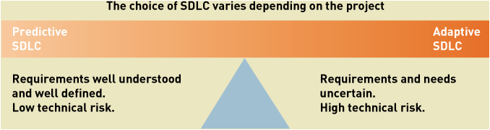
Types of SDLC

Slide 4
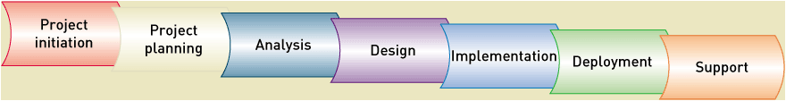
The traditional, predictive SDLC

Slide 5
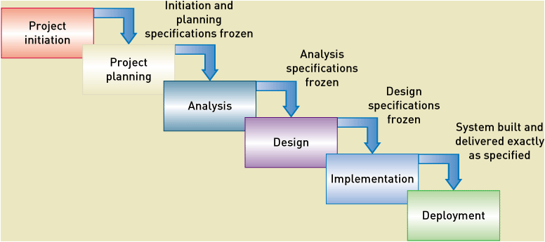
The traditional, predictive SDLC – Waterfall Approach

Slide 6
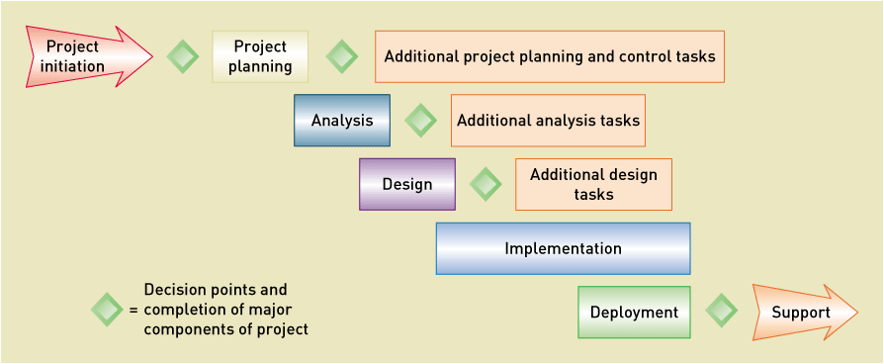
Variation on waterfall approach – some return upstream

Slide 7
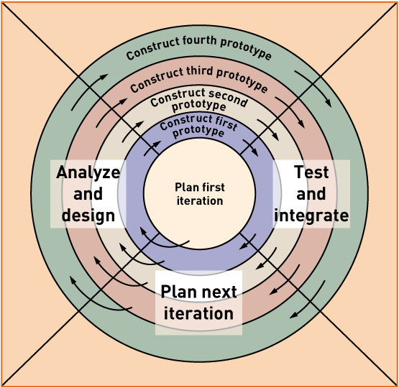
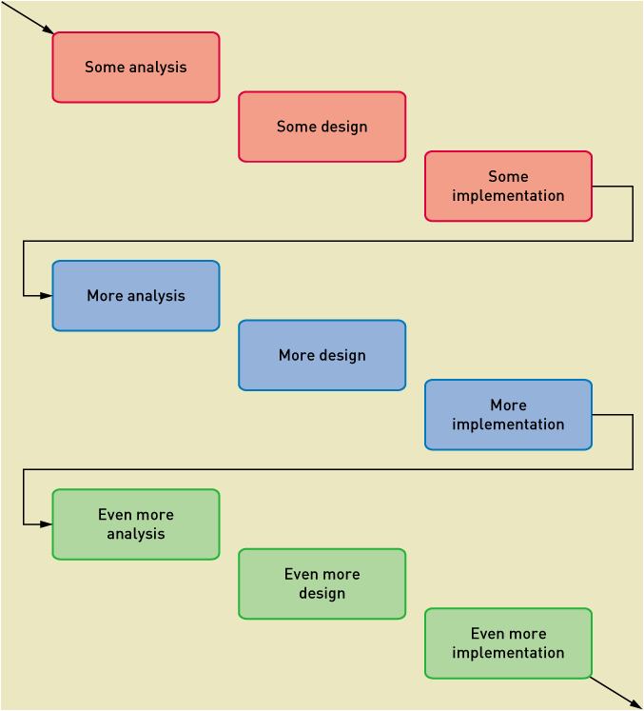
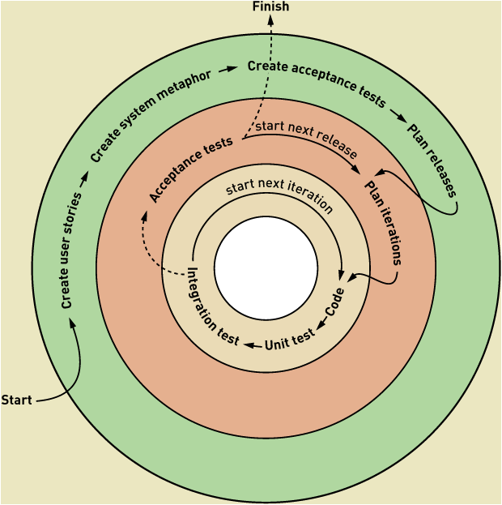
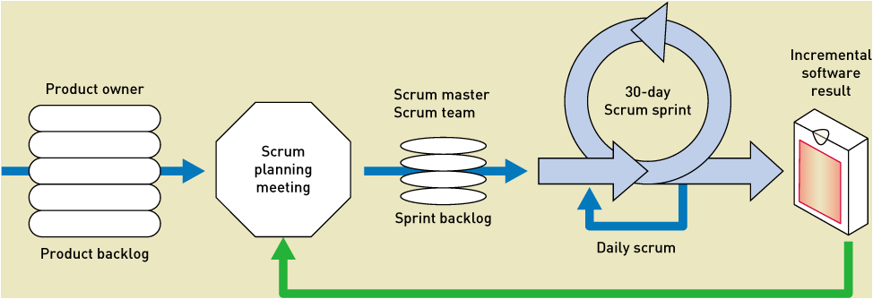
More Iterative/Adaptive Approaches to SDLC

Slide 8
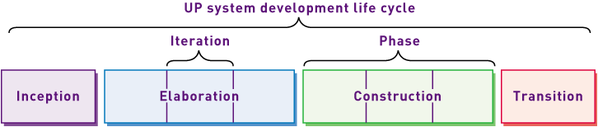
UP SDLC

Slide 9
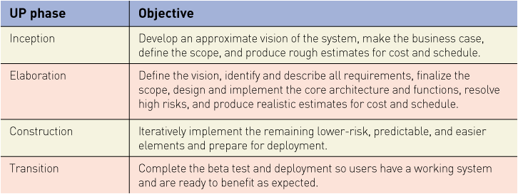
Objectives of UP SDLC Phases

Slide 10
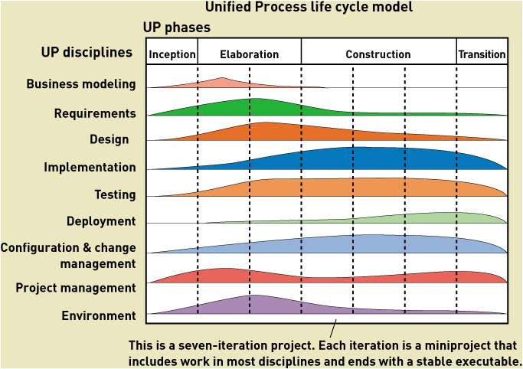

Slide 11
Simplified “Unified Process” SDLC

Slide 12
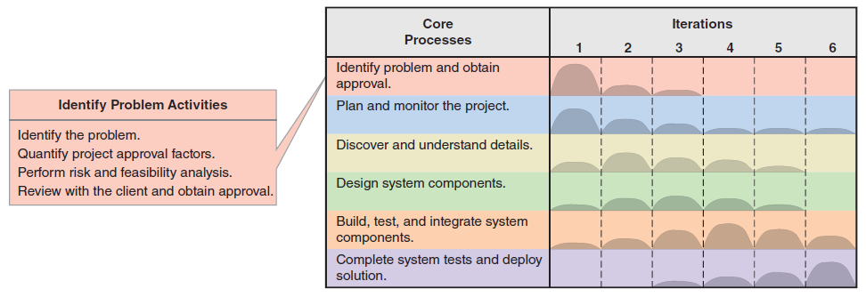
Systems Development Planning Activities: Identification of Problem and Approval Process

Slide 13
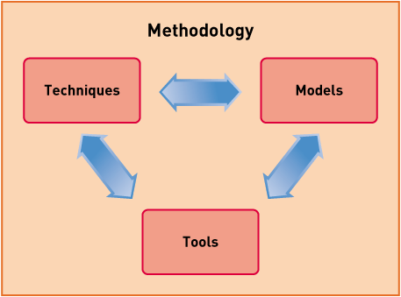
Methodologies
Structured Methodologies
Object Oriented Methodologies

Slide 14
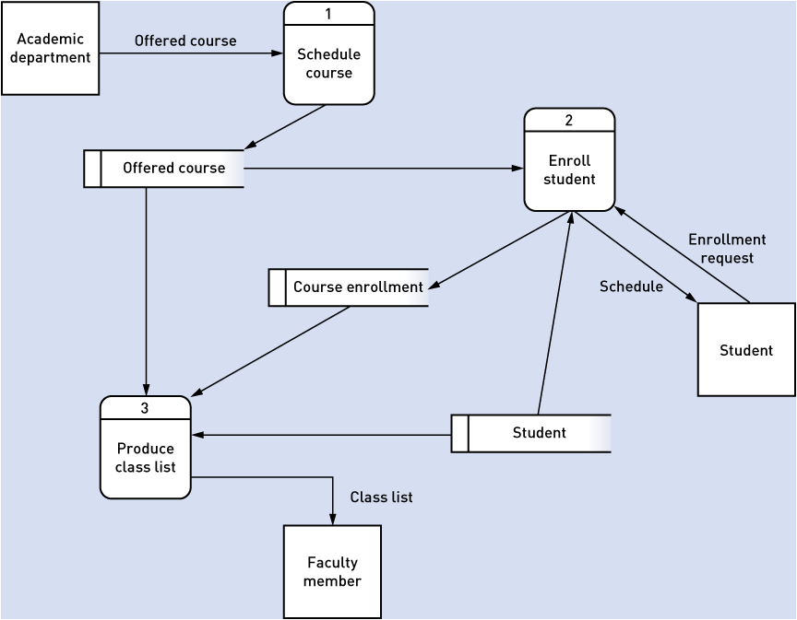
Structured Methodologies
Data Flow Diagram (DFD)

Slide 15
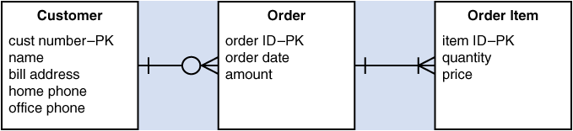
Structured Methodologies
Entity Relationship Diagram (ERD)

Slide 16
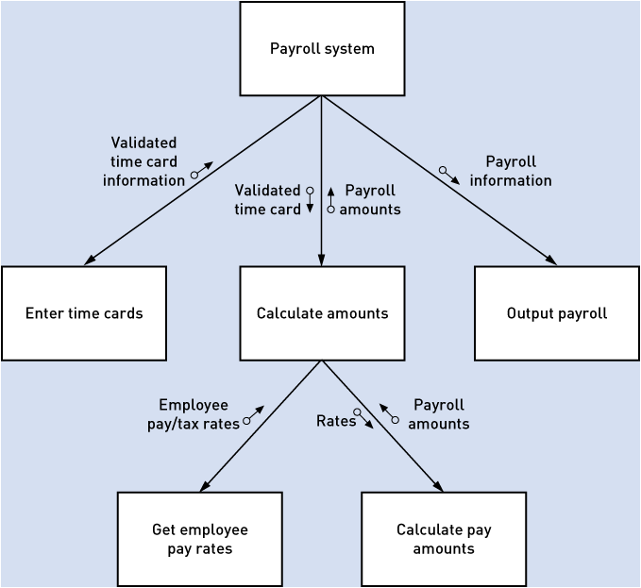
Structured Methodologies
Structure Chart

Slide 17
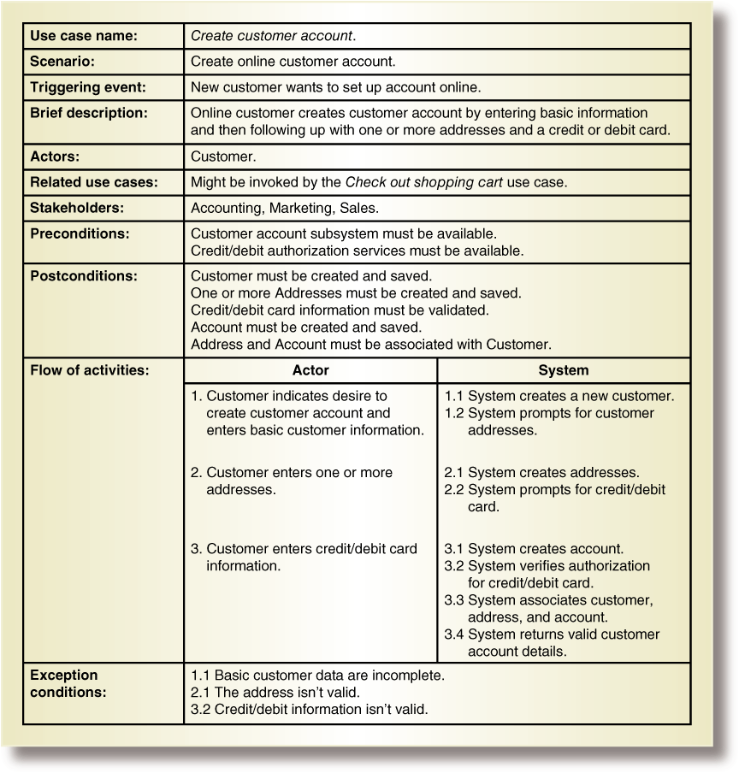
Object Oriented Methodologies
Use Case Description

Slide 18
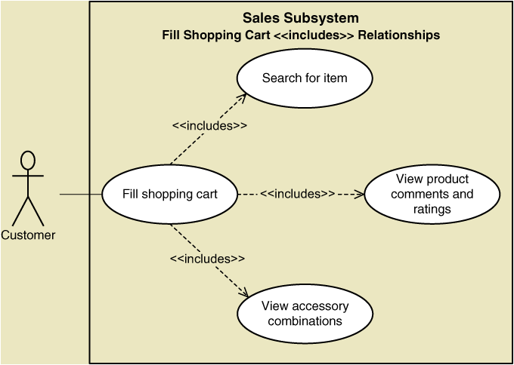
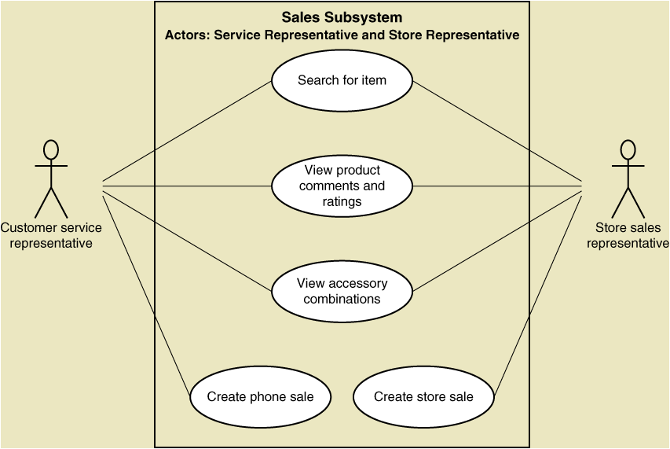
Object Oriented Methodologies
Use Case Diagrams

Slide 19
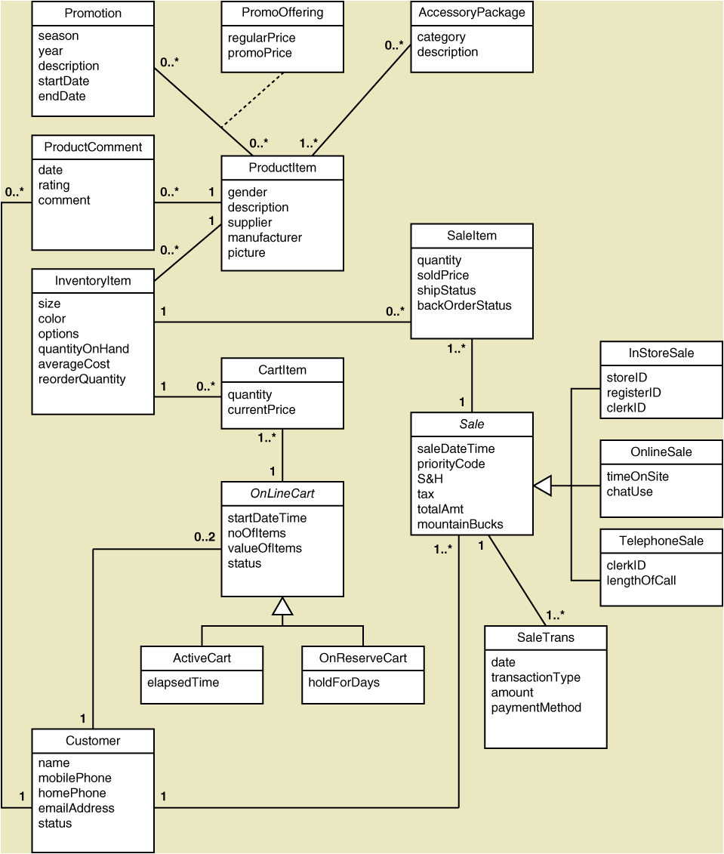
OO Methodologies
Class Diagram

Slide 20
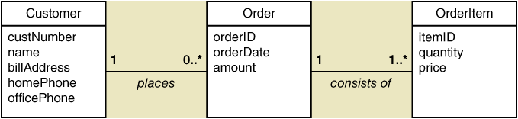
ERD vs Class Diagrams

Slide 21
Simplified “Unified Process” SDLC
INFO2000 –
project + tests +exam
INFO2000 – portfolio + tests + exam
INFO2001 –
project + tests +exam

